Slide 1
NYC Open Data: Motor Vehicle Collisions
Fausto Rodriguez, Sahil Desai, Justin Sciglimpaglia

Slide 2

The Data
Source: NYC Open Data (link)
Agency: NYPD
Updated daily
1.61m rows
29 Columns
Each row is a recorded crash
Notes:
Slide 2. Briefly talk about what is in the original data source. borough, crash dates beginning from 2012 for year, vehicle type etc.

Slide 3
Data Cleaning
1,595,863 rows, 29 columns
Dropped the columns we didn’t need for the questions we were asking
Removed NA observations in “BOROUGH” column
Changed the “YEAR” column to be recognized as a datetime type
Renamed columns for “REASON” of crash and “VEHICLE TYPE”
Removed “Unspecified” observations in “REASON”
After cleaning..
455,817 rows, 18 columns
Notes:
At the time of exporting the dataset for this project…
Slide 3. Read off of it. Specify columns you took off, such as time of crash. Location coordinates which was just a union of latitude and longitude, and collision ID. These weren’t needed for our questions specifically. For rename say an example would be changing the contributing factor for vehicles involved columns to reasons

Slide 4
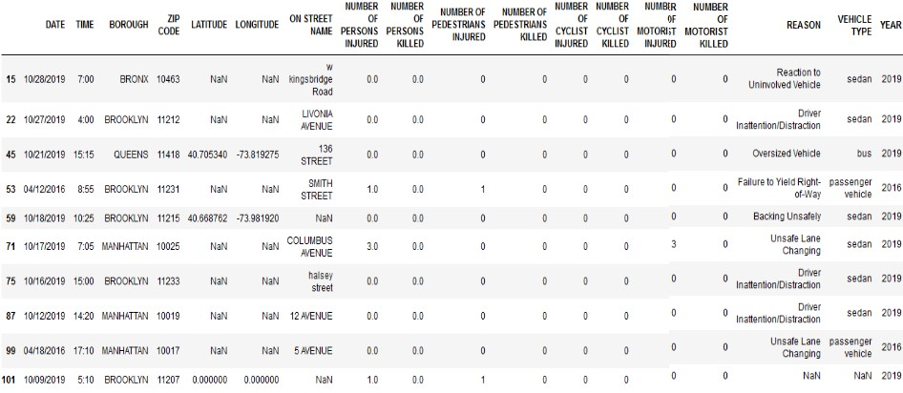
How the data looks

Slide 5
What Type of Vehicle is Safest?

Slide 6
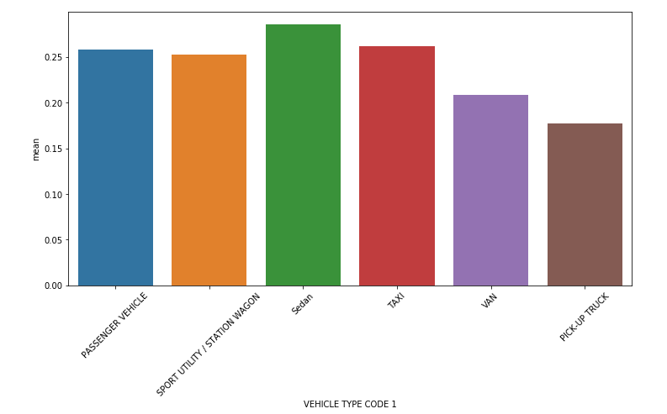
Average Number of People Injured Per Accident
From Left to Right:
Passenger Vehicles
SUV / Station Wagons
Sedan
Taxi
Van
Pick-up Truck
Notes:
Over the years, the average Number of persons injured in a crash per vehicle type.

Slide 7
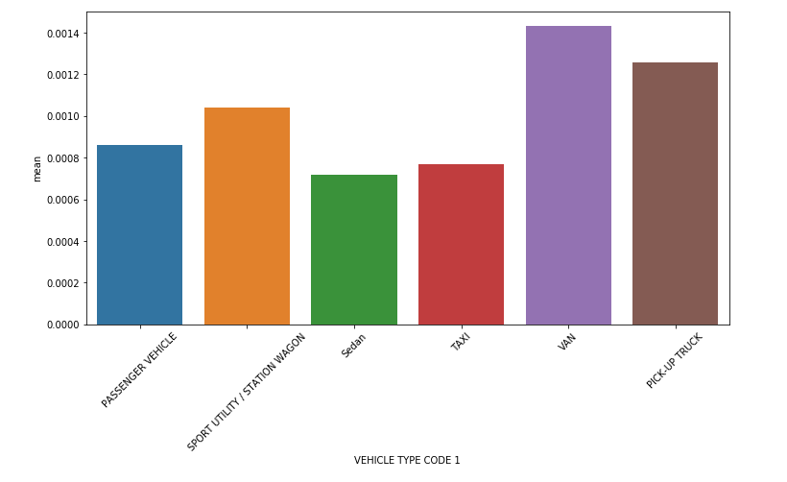
Average Number of People Killed Per Accident
From Left to Right:
Passenger Vehicles
SUV / Station Wagons
Sedan
Taxi
Van
Pick-up Truck

Slide 8
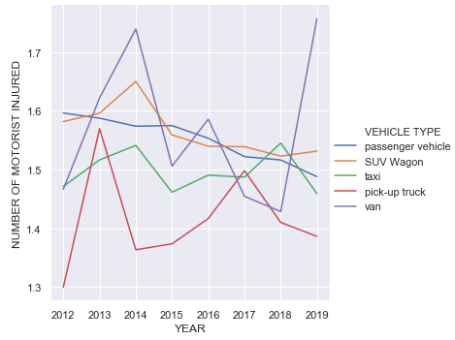
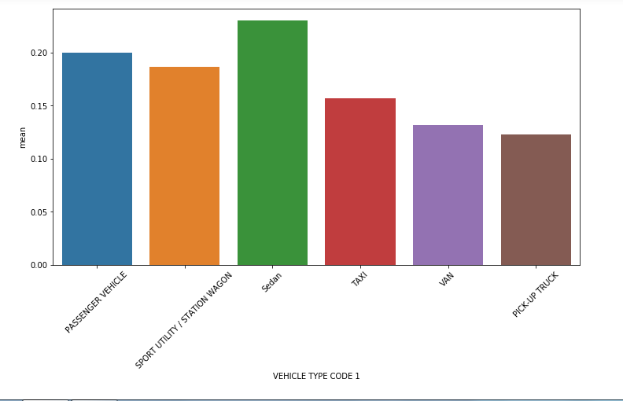
Average Number of Motorist Injured Per Accident
Notes:
The y-axis is the average amount of people who get injured recorded in that year

Slide 9
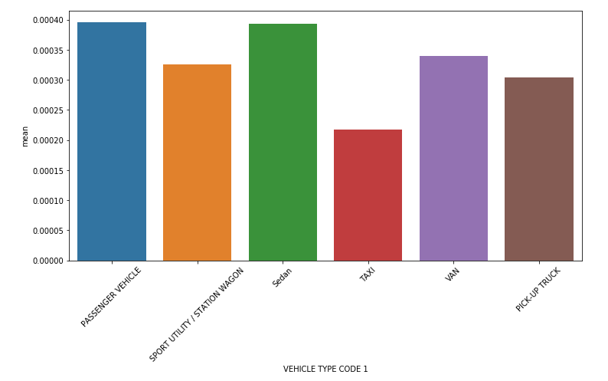
Average Number of Motorist Killed Per Accident
From Left to Right:
Passenger Vehicles
SUV / Station Wagons
Sedan
Taxi
Van
Pick-up Truck

Slide 10
Which Type of Car is Safest?
We conclude that the pick-up truck is the safest type of car
Ranked Respectively
  1
  5
  1
  2
The worst ranking, fifth, is people killed, but that category includes cyclist killed and pedestrians killed, which has nothing to do with the safety of the car type itself
Pick-up Trucks had consistently one of the lowest standard deviations (Not shown in the Presentation)

Slide 11
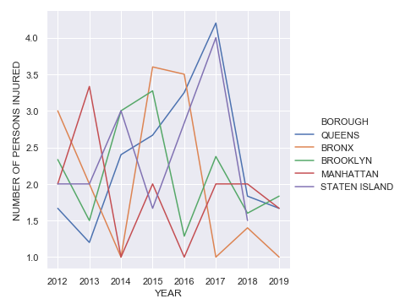
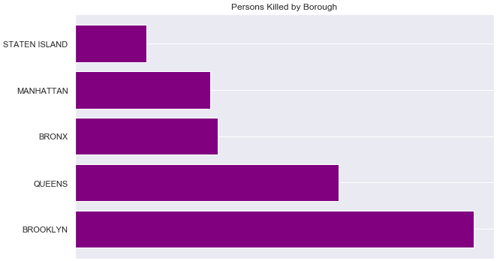
Which Borough is safer?
Two metrics: Persons Injured, Persons Killed
Notes:
The count for number of persons killed in crashes is higher in Brooklyn.Using the number of persons killed metric, Staten Island is a safer borough to drive in.
Number of persons injured in crashes shows us that the Bronx is safer and that Brooklyn has more injuries per crash on average. Manhattan and Queens are at the same level.

Slide 12
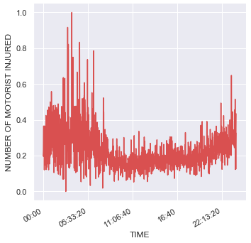
Most Dangerous Time To Drive For Motorists
Notes:
12AM, 8AM, and 4PM are the most dangerous times

Slide 13
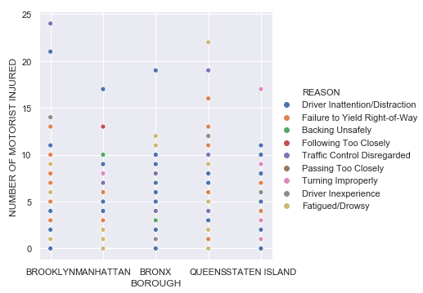
What were the causes for the crash? (That injured the most motorists)
Top Reasons in each borough
Bronx, Queens, Brooklyn, Staten Island: Traffic Control Disregarded
Manhattan: Driver inattention/Distraction
Notes:
Cause of crash that hurt the most motorists
Bronx - Driver Inattention/Distraction
Brookyln - Traffic Control Disregarded
Manhattan - Driver Inattention/Distraction
Queens - Fatigued/Drowsy
Staten Island - Turning Improperly

Slide 14
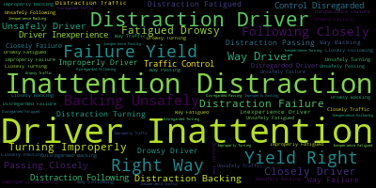
text = " ".join(reason for reason in df.REASON)
useless = set(STOPWORDS)
wordcloud = WordCloud(stopwords = useless, background_color = 'black', max_words = 400, max_font_size = 40).generate(text)
Notes:
The word cloud was made by making a long list filled with the “Reasons” for the crashes and importing the library WordCloud. Its basically a list of all the most common words in the column reason and the phrases are ranked by its size and all have different colors. Can also predict that this word cloud is probably true for all states in the U.S and that is why car companies are taking precautionary measures such as installing handsfree software now to decrease this

